Slide 1

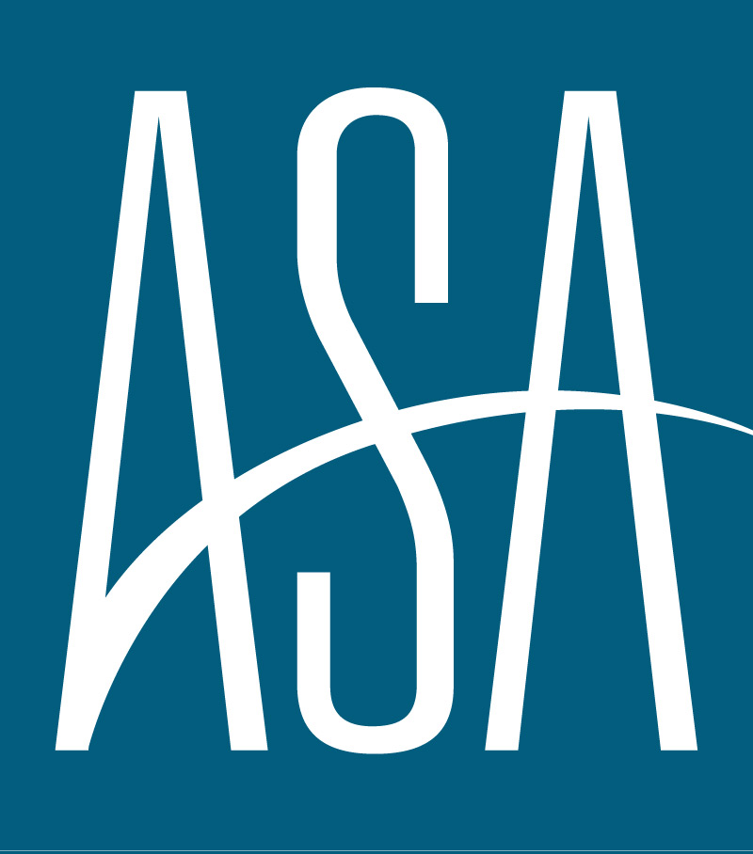
AMERICAN STAFFING ASSOCIATION
ECONOMIC & STAFFING FORECAST
APRIL 2025

Slide 2




“A gradual uptick in price growth coupled with some deceleration in labor churn portends mild disruption to an otherwise promising trajectory for staffing demand.
Noah Yosif
Chief Economist, American Staffing Association
EXECUTIVE SUMMARY
GDP
INFLATION
LABOR MARKET
STAFFING
GDP is expected to grow by 1.3 percent in 2025Q2. Annual growth is expected to trend at 1.6 percent.
Core CPI is expected to rise to 3.5 percent year-over-year in 2025Q2. Core PCE is expected to rise to 3.6 percent year-over-year in 2025Q2.
The Unemployment Rate is expected to increase to 4.4 percent in 2025Q2.
Staffing Employment is expected to decline by 6 percent in 2025Q2, up from 5.4 percent in 2025Q1.

Slide 3
GDP
We project GDP to rise to 1.3 percent in 2025Q2 as consumers adjust to the initial shock from tariffs. Healthy levels of labor market activity will enable consumers to remain resilient despite rising inflation and tightening economic conditions. Policy-related tailwinds including tax reform as well as long-term trade deals are expected to further augment economic activity through increased business investment as well as net exports.

Slide 4
INFLATION
We expect cost-push inflation to rise in 2025Q2 owing to current tariffs as well as broader uncertainties over trade policy, with Core CPI and Core PCE to 3.5 percent and 3.6 percent, respectively. Should labor market activity remain healthy, complemented by a quicker-than-expected retrenchment in prices, we see the Federal Reserve keeping to its forward guidance of two interest rate cuts in 2025.

Slide 5
LABOR MARKET
The potential for reduced economic growth combined with elevated inflation will, at best, keep long-term personnel decisions on pause or, at worst, prompt employers to begin reducing headcount. These trends will enable slower nonfarm payroll growth at just 0.5 percent in 2025Q2 as well as a modest uptick in unemployment at 4.4 percent.

Slide 6
STAFFING EMPLOYMENT
The continued freeze in labor market activity will foster a modest decline in staffing employment by 6.0 percent in 2025Q2. We expect modest deterioration within light industrials as employers are constrained by increased operating costs, in conjunction with plateauing demand in services-oriented verticals including Healthcare as well as Engineering, IT, and Scientific services owing to a consequent rise in borrowing costs.

Slide 7




Methodology
The ASA Economic & Staffing Forecast synthesizes monthly data to generate real-time predictions about the current state of the economy. It is based on a dynamic factor model using principal components analysis and Bayesian estimation techniques.
ASA Research Department
Noah Yosif
Chief Economist
Tim Hulley
Disclaimer
Associate Director of Research
Analyses, estimates, forecasts, opinions, and other views contained within this document herein belong to the ASA Research Department. While the ASA Research Department uses many assumptions to ensure the accuracy of all analyses, estimates, forecasts, and opinions, they are not intended for any specific purpose, and any projected outcomes are not guaranteed, Changes in underlying assumptions, as well as incoming data, may foster materially different results. The analyses, estimates, forecasts, and opinions of the ASA Research Department represent those to-date, and do not necessarily reflect the views of ASA management, staff, members, and/or affiliated organizations.
Maxwell Aldrich
Research Coordinator

