Slide 1



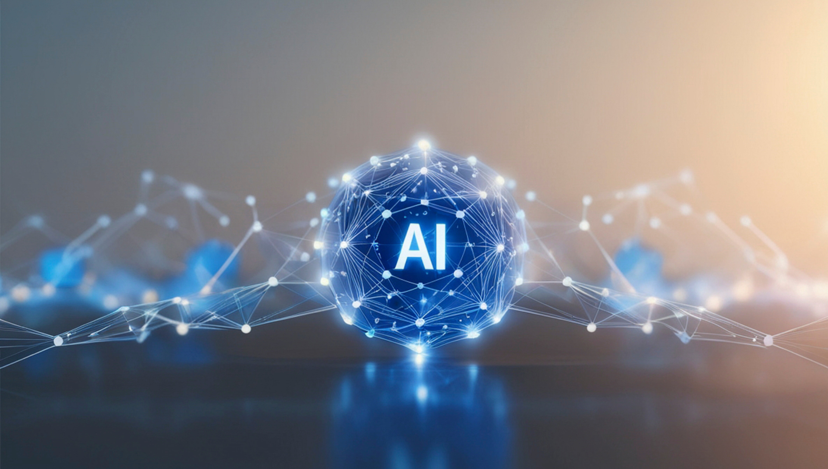
[COMPANY LOGO]
Bring AI-Skilled Talent Into
Your Business Faster and
Without Risk
Research from the American Staffing Association and LinkedIn shows staffing professionals are developing AI capabilities at a significantly faster rate than the rest of the workforce.
46%
Faster AI
Skills Growth
+7%
AI Engineering
Skills Advantage
Staffing professionals are building
AI literacy faster than the broader workforce.
Compared to overall
LinkedIn members.
WHAT THIS MEANS FOR
YOUR BUSINESS
Test AI Capabilities Without Permanent Commitment
Deploy AI-Skilled Talent Quickly
Increase Output Without Expanding Headcount
Pilot AI-enabled workflows using contract talent before making large investments in permanent hires.
Gain immediate access to workers with modern skills without the delay, cost, and risk of permanent onboarding.
Move faster and deliver more while keeping the company’s internal team focused on your
core mission.
PARTNER WITH [MEMBER COMPANY]
At [Company Name], we connect organizations with highly skilled professionals who possess the technological skills to advance your business.
Phone Number
Email
Website
Source American Staffing Association and LinkedIn, The State of Staffing & Search

